Slide 1
The road to $1b in gross revenue
FY 2019 Workforce planning

Slide 2
Strategy 1: grow book of business by 30%

Slide 3
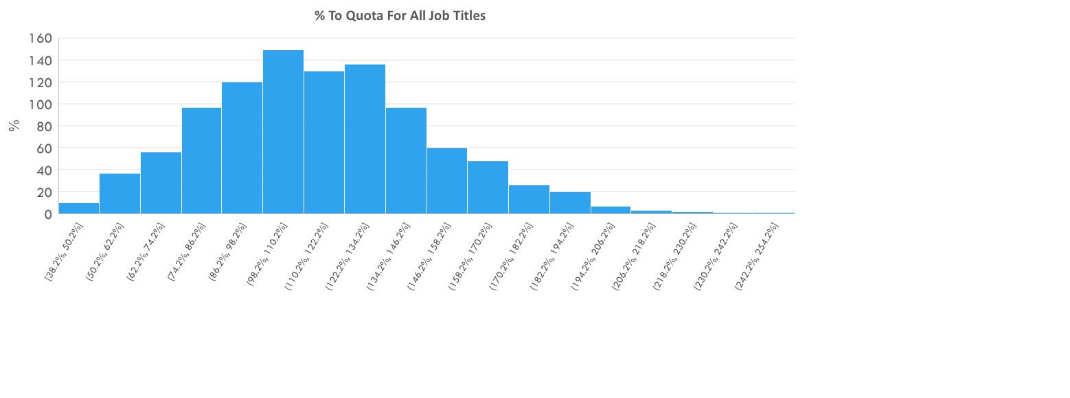
Strategy 2: increase quota and commissions
Adds $67M in Gross Revenue

Slide 4
Strategy 3: increase headcount

Slide 5
Revenue outcome by strategy

Slide 6
Can all three work together?
new Account growth 30%
higher quotas and commissions to boost motivation
Increased headcount +200

Slide 7
Combined impact

